Slide 1
What can be monitored ?
A web server/app server/database server etc…. Are up & running or not
Resources such as CPU/Memory/DiskSpace/Network Storages etc…
Hardware Devices:
Network adapters, printers, routers, etc…
Monitoring is the regular observation and recording of activities taking place in a system
the purpose of monitoring and evaluation is to track implementation and outputs systematically, and measure the effectiveness of programmes. It helps determine exactly when a programme is on track and when changes may be needed

Slide 2

DevOps 2019

Slide 4

Agenda
What is Nagios
Nagios core/xi/fusion
Nagios Features
Nagios Architecture
Nagios plug-ins
Nagios Configuration

Slide 5
Nagios
Nagios is an open source tool especially developed to monitor hosts and services and designed to inform the network incidents before end-users, clients do
It watches hosts, services and switches etc.… which we specify and alerts when things go bad and when things get recovered
Initially developed for servers and application monitoring, it is now widely used to monitor networks availability
There are large number of systems and services running in the IT Infra
There can be failure of any service or systems at any time
There is constant need of monitoring and alert system

Slide 6
Nagios Core/XI/Fusion
Nagios Core: Nagios is an open source monitoring system for computer systems. It was designed with core components to run on the Linux operating system and can monitor devices running Linux, Windows and Unix Oses
Nagios XI: Nagios® XI™ is the most powerful and trusted network monitoring software on the market. Nagios XI extends on proven, enterprise-class Open Source components to deliver the best network, server and application monitoring solution for today's demanding organizational requirements
Nagios Fusion: Fusion is designed to scale with your organization. Remote Nagios servers distribute the load associated with monitoring and performance graphing. As your infrastructure grows, your monitoring environment can expand without increasing load or management requirements at the central node

Slide 7
Features of Nagios
Monitoring of network services (SMTP, POP3, HTTP, NNTP, PING etc..)
Monitoring of host resources (Disk usage etc..)
Parallelized service checks
Simple plug-in design that allows users to easily develop their own service checks
Contact notifications when service or host problems occur and get resolved (via email, pager, sms or user defined method)
Automatic Log Rotation
Ability to define network host hierarchy using parent hosts
Support for implementing redundant monitoring hosts
Optional Web Interface for viewing current network status, notification and problem history, log file etc…

Slide 8
With Nagios we can
Monitor your entire IT infrastructure
Spot problems before they occur
Know immediately when problems arise
Share availability data with stakeholders
Detect security breaches
Plan and budget for IT upgrades
Reduce downtime and business losses

Slide 9
Nagios Key Concepts
Colored area concept
Green/Yellow/Red (Ok/Warning/Critical)
No performance analysis or display (a priori )
Checks using external commands (plugins)
Various possibilities for remote checks
Possibility for passive checks (from managed resources)
Web interface + notiﬁcations

Slide 10
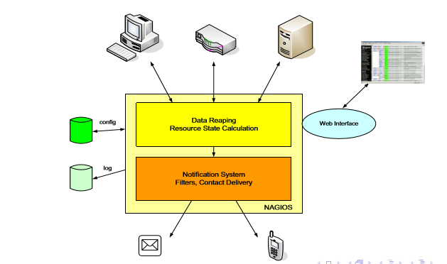
Nagios Architecture

Slide 11
Nagios Architecture at runtime
Data reaping + notiﬁcation system= nagios processes
Can be run as a service (rcX.d, soft runlevel)
Web interface
External web server (Apache)
Bunch of cgi scripts (part of Nagios)
Conﬁguration
Simple text ﬁles
Or a postgres database
Logs (local ﬁles)
Named pipe (unix domain socket) to enable nagios to receive commands (from cgi, passive asynchronous events)

Slide 12
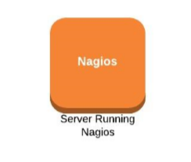
Nagios Architecture

Slide 13
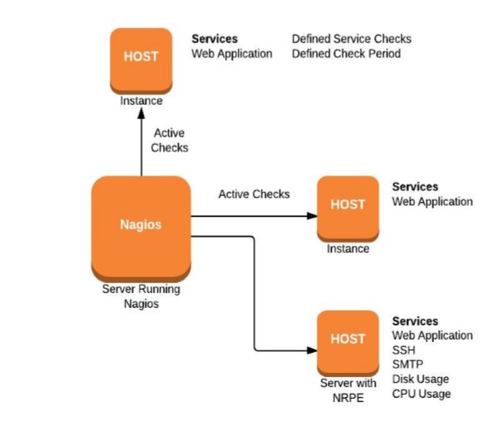
Nagios Architecture

Slide 14
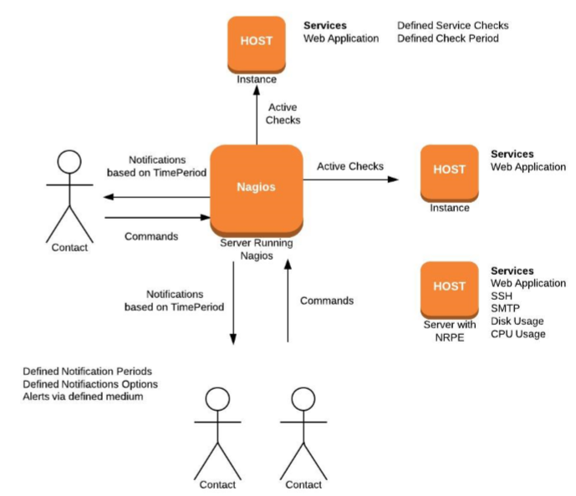
Nagios Architecture

Slide 15
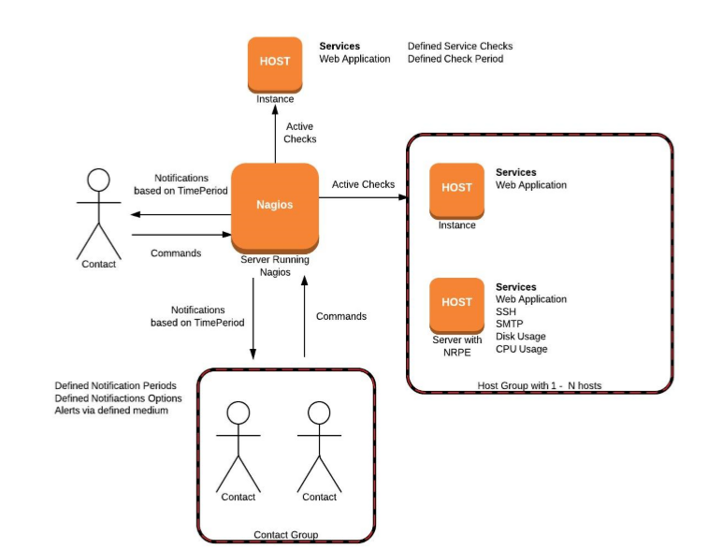
Nagios Architecture

Slide 16
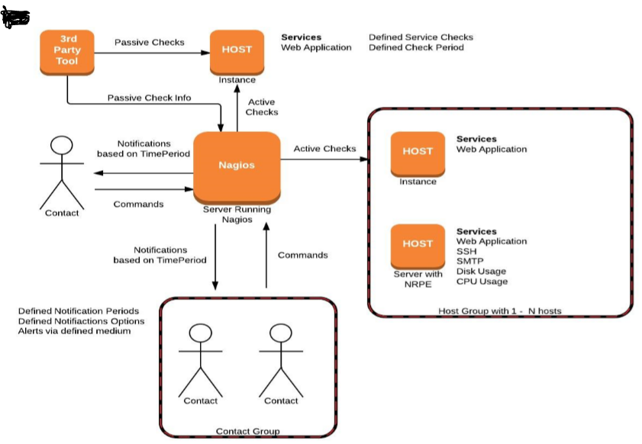
Nagios Architecture

Slide 17
Nagios Definitions
Host
Service
Contacts
Commands
Time Period
Event handlers

Slide 18
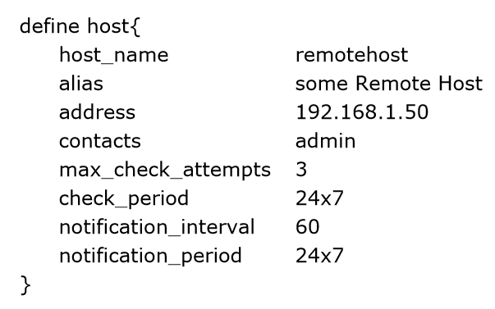
Host
Defines a physical server, workstation, device, etc. that resides on your network.

Slide 19
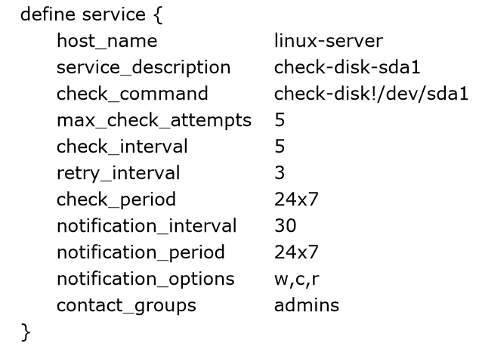
Service
Its a service that runs on the host.
Actual service on the host like POP, SMTP, HTTP, etc.)
Metric associated with the host (response to a ping, number of logged in users, free disk space, etc.

Slide 20
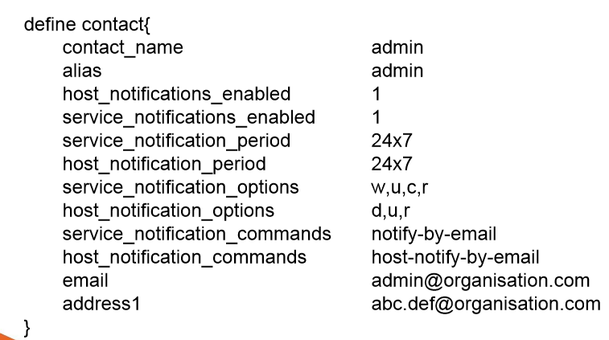
Contacts
Identify someone who should be contacted in the event of a problem

Slide 21
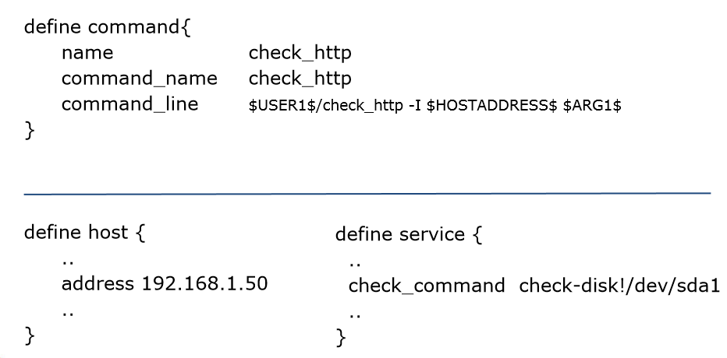
Commands

Slide 22
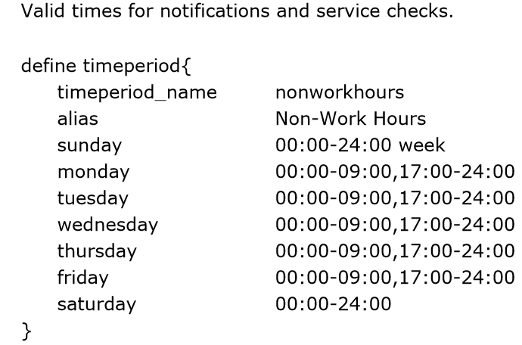
Time Periods

Slide 23
Event Handlers
Event handlers are optional system commands (scripts or executables) that are run whenever a host or service state change occurs.
Restarting a failed service
Entering a trouble ticket into a helpdesk system
Logging event information to a database
Cycling power on a host
Event handlers are executed when a service or host
Is in a SOFT problem state
Initially goes into a HARD problem state
Initially recovers from a SOFT or HARD problem state

Slide 24
Monitoring Services
Nagios can be used to monitor Public and Private Services
Private Services
CPU load
Memory usage
Disk usage
Logged in users
Running processes
Publicly available services that are provided by Linux servers
HTTP
FTP
SSH
SMTP

Slide 25
Reports
Nagios can be used to generate various reports
Availability Report
Trends Report
Alert History Report
Alert Summary Report
Alert Histogram Report
Notification Report

Slide 26
Summary
Infra monitoring
Anomaly Outage detection
Automatic Problem remedy
Schedule Downtime
Outage Alerts
Alert Escalations
Historical Reporting
Maintenance Planning

Slide 27


